Slide 1
Insole Design for Additive Manufacturing – Current Developments and Future Trends
Tatjana Spahiu¹, Ioannis Ntintakis², Ioannis Sarris³
¹Polytechnic University of Tirana, Albania
²Hellenic Mediterranean University, Estavromenos, 714 10 Heraklion, Crete, Greece
³University of West Attica, 12244 Athens, Greece
SmartTecStyle conference 2024 11 – 12 December

Slide 2
Content
Insoles – definitions, importance, history
Main materials used for production
Methods to design and manufacturing insoles
Smart insoles – a solution to monitor consumers
for different purposes
Current and future trends
SmartTecStyle conference 2024 11 – 12 December

Slide 3
Definitions of insoles
Insoles are thin pieces inserted inside a shoe. They are the contact point between the foot or human body and the sole or the lower part of the shoes.
SmartTecStyle conference 2024 11 – 12 December

Slide 4
Definitions of insoles
General word used for the piece that located inside of the shoe in contact with the foot.
It’s the part of the shoe that lies under the bottom of the foot.
Insoles are also referred to as shoe inserts.
Insoles are also often called foot beds.
SmartTecStyle conference 2024 11 – 12 December

Slide 5
Definitions of insoles
The International Organization for Standardization defines an orthosis as “an externally applied device”.
SmartTecStyle conference 2024 11 – 12 December

Slide 6
The role of insoles
Foot orthoses or insoles have different applications depending on the type of shoe and modify the structural and functional characteristics of the neuromuscular and skeletal systems.
Insoles
Moisture control
Comfort
Attached
Movable
Odor control
Reduce foot pain
Postural support
SmartTecStyle conference 2024 11 – 12 December

Slide 7
Brief history of Insoles
Data found highlight the use of insoles since more then150 years ago.
1958 that the era of modern foot orthosis therapy began.
Podiatrist, Merton Root, began to fabricate thermoplastic foot orthoses
SmartTecStyle conference 2024 11 – 12 December

Slide 8
Main materials for insole production
Thermoplastics
Foams
Spenco
Acrylic
Leather
Vinil
Carbon fiber composite
Cork
Source: Nicolopoulo, C.S. et al., Foot, 10, 1, 2000.
SmartTecStyle conference 2024 11 – 12 December

Slide 9
Main materials for insole production Thermoplastics
Plastic that turns soft when heated and hard when cooled
Thermoplastics | Usage | Advantages | Disadvantages
Polypropylene | Shell material | lightweight, high stiffness | prone to cracking if notches or grooves are introduced
Polyethylene |  | durable, lightweight, flexible, malleable, and resilience to compression | limited shock absorption
Source: Nicolopoulo, C.S. et al., Foot, 10, 1, 2000.
SmartTecStyle conference 2024 11 – 12 December

Slide 10
Main materials for insole production Acrylic Carbon fiber composite
methyl methacrylate polymer
combination of acrylic plastic with carbon fibers
Materials | Usage | Advantages | Disadvantages
Acrylic | Shell material | tough and remoldable | prone to cracking
Carbon fiber composite | Shell | thin, ultralight weight, rigid, extremely durable, and retains shape | difficult to cut and inability to remold
Source: Nicolopoulo, C.S. et al., Foot, 10, 1, 2000.
SmartTecStyle conference 2024 11 – 12 December

Slide 11
Main materials for insole production Foams
cellular material classified as closed cell (isolated air pockets) or
open cell (porous air pockets) with varying densities, such as soft or firm
Types of foams | Usage | Advantages | Disadvantages
EVA (ethyl vinyl acetate) foam | topcover (soft), accommodations (firm), shell (firm) | shock absorption (soft), durable, resists tearing, rigid (firm), heat moldable | compressibility (soft), limited cushioning (firm)
Polyurethane foam | top layer, cushioning | high shock absorption, resists compression | durability as a top cover and not heat moldable
Polyethylene foam | top cover (soft), shell (firm) | tough, durable, malleable, lightweight, flexible, heat moldable | moderate shock attenuation, easily compressed
Source: Nicolopoulo, C.S. et al., Foot, 10, 1, 2000.
SmartTecStyle conference 2024 11 – 12 December

Slide 12
Main materials for insole production
Leather, Cork, Spenco and Vinyl are all used for the top cover of the insole
Materials | Advantages | Disadvantages
Leather | low friction, durable, thin, tear resistant, absorbs moisture | no cushioning, remains damp, and stains
Cork | Lightweight | Durability
Spenco | Soft cushioning system to help absorb shock and reduce friction | Durability
Vinyl | tough, long-lasting, extremely thin, resists tearing, does not absorb moisture, minimal friction | No cushioning
Source: Nicolopoulo, C.S. et al., Foot, 10, 1, 2000.
SmartTecStyle conference 2024 11 – 12 December

Slide 13
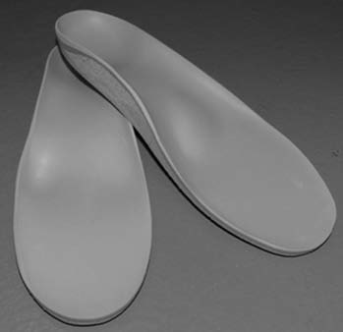
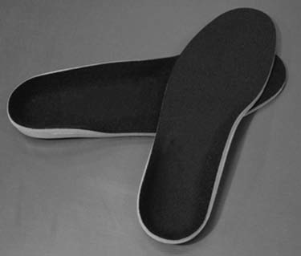
Insoles production
Mass-produced insoles
Custom-made insoles, or custom foot orthotics
Manufactured for basic needs
odor and moisture control,
arch support, or
extra-cushioning
Manufactured with extra features based on the specific needs of the individual
SmartTecStyle conference 2024 11 – 12 December

Slide 14
Customized insoles based on traditional method
Orthotic insoles can be produced by starting with the footprint in a foam of box
Low precision
Low comfort
Low accuracy
High costs
Time consuming
SmartTecStyle conference 2024 11 – 12 December

Slide 15
Advanced technologies for insoles production
Personalized insoles are becoming a trend not only for fit and comfort but for aesthetical purposes too.
Design and fabrication of custom insoles/foot orthoses
1
Capturing the geometry
2
Manufacturing
3
Design of the device
SmartTecStyle conference 2024 11 – 12 December

Slide 16
Customized insoles based on digital twin
Studies propose a customized insole design framework for individual foot shapes by constructing a digital twin model between a finite element analysis (FEA)based virtual model and an actual physical model.
Foot pressure data from the physical model were used as a load condition for the FEA model, and the insole material properties were tuned to maximize the similarity between the FEA model and the real model using virtual sensors.
Results: The obtained digital twin model corrected the abnormal arch index of the cavus foot to normal through position optimization of the partial insole, and subsequently balanced the front and rear of the foot.
Kim, J., Choi, J., Kang, YJ. et al. Development of Customized Insole Design Framework Based on Digital Twin. Int. J. Precis. Eng. Manuf. 25, 785–798 (2024). https://doi.org/10.1007/s12541-023-00952-y
SmartTecStyle conference 2024 11 – 12 December

Slide 17
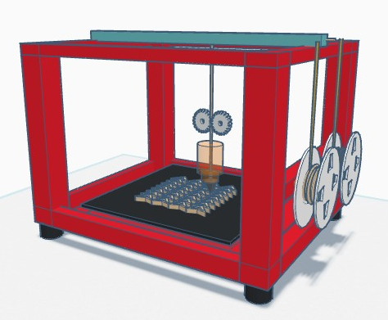
3D printing technology
Three-dimensional (3D) printing is an additive manufacturing process that creates a physical object from a digital design.
The process works by laying down thin layers of material in the form of liquid or powdered plastic, metal or cement, and then fusing the layers together.
SmartTecStyle conference 2024 11 – 12 December

Slide 18
Advantages of 3D printed customized insoles
Breathability and Moisture Management
Enhanced Support and Cushioning
Cost-Effectiveness
Sustainability and Eco-Friendliness
Personalization and Custom Fit
SmartTecStyle conference 2024 11 – 12 December

Slide 19
Advantages of 3D printed customized insoles
3D printing enables the creation of insoles according to foot shape, size, and gait.
It ensures optimal comfort and support, reducing the risk of foot pain and injuries.
3D printed insoles can be designed with complex structures and varying densities.
This provides custom support and cushioning.
Especially for people with specific foot conditions or high-impact activities.
SmartTecStyle conference 2024 11 – 12 December

Slide 20
Advantages of 3D printed customized insoles
The materials used in 3D printing, such as nylon or TPU, allow for better breathability and moisture management.
This helps keep feet dry and comfortable, reducing the risk of blisters and other skin irritations.
3D printing reduces material waste and enables on-demand production, making it a more sustainable and eco-friendly option compared to traditional manufacturing methods.
SmartTecStyle conference 2024 11 – 12 December

Slide 21
Advantages of 3D printed customized insoles
While the initial investment in 3D printing technology may be higher, the long-term cost savings are significant.
Custom insoles can be produced quickly and cheaply, without the need for expensive tooling or minimum order quantities.
SmartTecStyle conference 2024 11 – 12 December

Slide 22
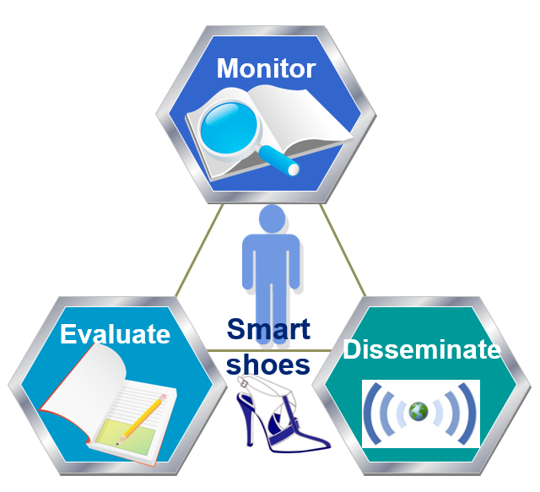
Smart products - insoles
A smart, or connected, product is a device that is linked to the Internet.
The data provided by smart products can be used to monitor and optimize usage,
Provide health status or location and
Predict/prevent failures by anticipating service needs.
SmartTecStyle conference 2024 11 – 12 December

Slide 23
Smart products - insoles
Recognizing human activities in controlled and uncontrolled environments is an ongoing work of many researchers.
As smart shoes/insoles can detect data about humans, there are two main two main categories in terms of the devices used:
Vision-based HAR (Human Activity Recognition)
Sensor-based HAR
Human Activity Recognition)
Analyze images or videos obtained from capture devices
Focus on processing data extracted from wearable/environmental
sensors
SmartTecStyle conference 2024 11 – 12 December

Slide 24
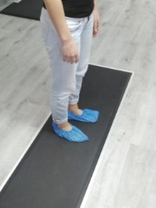
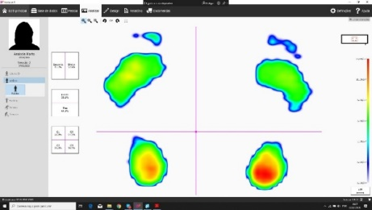
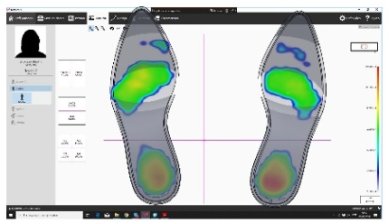
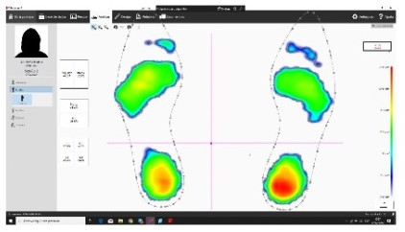
Insoles design for additive manufacturing
SmartTecStyle conference 2024 11 – 12 December

Slide 25
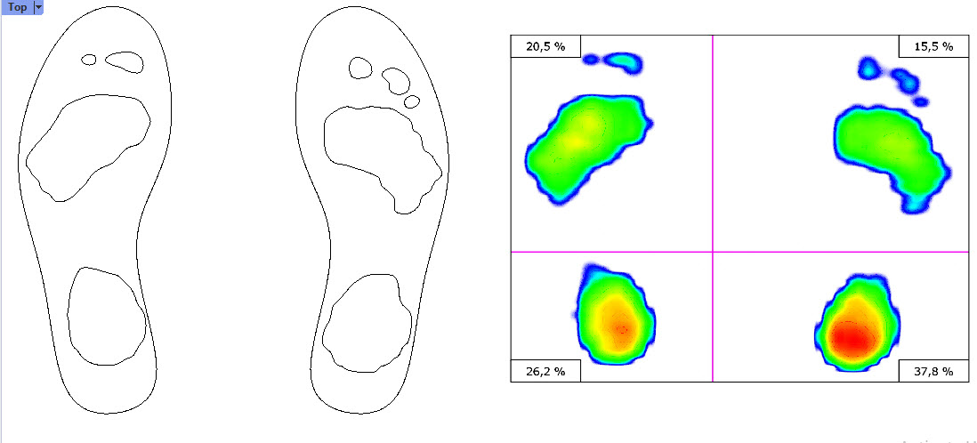
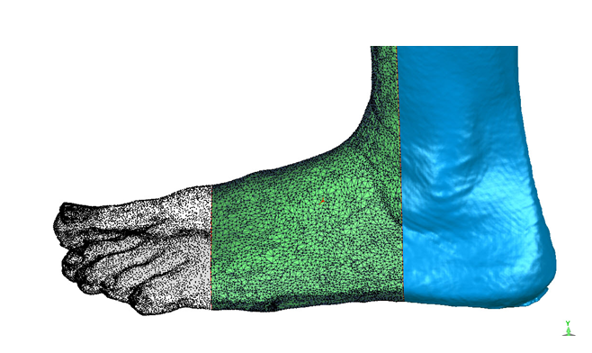
Insoles design for additive manufacturing
SmartTecStyle conference 2024 11 – 12 December

Slide 26
Conclusions
3D-printed orthotic insoles are becoming increasingly popular as a way to relieve foot pain and other conditions.
They are custom-made to fit the individual's foot and can be designed to address specific needs.
Compared to traditional way of capturing foot shapes and model forming processes, 3D scanning provides:
3D Scanning
High capturing speed
Reduced manual labor
High accuracy
Flexibility
SmartTecStyle conference 2024 11 – 12 December

Slide 27
Conclusions
The U.S. shoe insoles market size was estimated at USD 1.06 billion in 2023 and is projected to grow at a CAGR of 5.1% from 2024 to 2030.
Rise in sports and physical activities
Significant effect on the market for shoe insoles
Driving up customer demand for personalized insoles
Performance
Comfort
Lower injury risks
SmartTecStyle conference 2024 11 – 12 December

Slide 28
Conclusions
For rehabilitation medicine, traditional production technology can no longer fully meet the needs of patients.
3D printing technology has the advantages of individualization, which is small batches and high precision.
It can easily solve the problems of individual differences among patients and build a personalized health industry.
The gap between demand and production scale helps medical device manufacturers improve their production flexibility, also assisting doctors or researchers to bring better precision medicine solutions to patients.
SmartTecStyle conference 2024 11 – 12 December

Slide 29
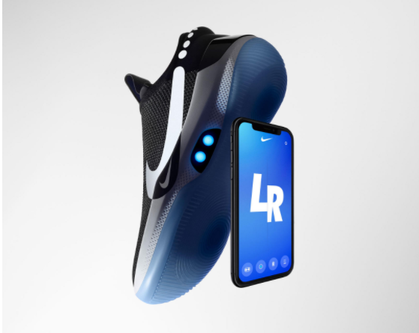
Conclusions
Smart insoles have the potential to become one of the top wearable’s soon
SmartTecStyle conference 2024 11 – 12 December

Slide 30
THANK YOU!
SmartTecStyle conference 2024 11 – 12 December

